Slide 1

Real Time Environmental Parameters Monitoring System using Wireless Communication Technology in Underground Mines
Team Members:
M Rishith - 21UEEE0505
K Harshanjali - 21UEEL0035
SVL Sai Neha - 21UEEA0113

Slide 2
OUTLINE
Abstract
Introduction
Literature Survey
Objectives
Methodology
Results & Analysis
Conclusion
References

Slide 3
ABSTRACT
Underground mining operations are critical to the global supply chain for vital minerals and resources, yet they pose significant safety risks due to hazardous environmental conditions. Traditional safety measures, such as manual inspections and standalone monitoring systems, often fail to provide real-time data required to avert accidents. This project introduces a Real-Time Environmental Parameters Monitoring System designed to address these safety challenges. By utilizing MSP430 and ESP8266MOD microcontrollers, the system continuously monitors vital parameters such as toxic gas levels, oxygen concentration, temperature, and humidity. The integration of IoT and cloud technology ensures real-time data transmission, comprehensive monitoring, and enhanced safety and operational efficiency in underground environments.

Slide 4
INTRODUCTION
Context: Importance of underground mining in the global supply chain for critical resources.
Problem Statement: Safety hazards in underground mining (toxic gases, insufficient oxygen, temperature fluctuations).
Traditional Solutions: Challenges with manual inspections and standalone systems.
Solution Overview: Introduction of a Real-Time Environmental Monitoring System using IoT, sensors, and wireless communication.

Slide 5
Key Safety Challenges in Underground Mining
Toxic Gas Accumulation: Methane, carbon monoxide, etc.
Oxygen Deficiency: Low oxygen levels that endanger miner health.
Temperature Fluctuations: Extreme heat or cold that impacts both miner safety and machinery.
Safety Risks: Health hazards, accidents, fatalities, and operational disruptions.

Slide 6
OBJECTIVES OF THE PROJECT
Monitor Environmental Parameters: Gas levels, temperature, humidity, and oxygen concentration.
Cloud Integration: Store and access data remotely for improved decision-making.
Scalability: System can be adapted to various underground mining environments.
Cost-Effectiveness: Implement a solution that is affordable and efficient.

Slide 7
COMPONENTS AND TECHNOLOGY
MSP430 Microcontroller: Provides low-power data acquisition, ensuring long-lasting performance in challenging underground environments.
ESP8266MOD Microcontroller: Facilitates IoT capabilities with Wi-Fi connectivity, enabling real-time data transmission and remote access.
Wireless Communication: Utilizes Wi-Fi (via ESP8266MOD) to ensure stable data transmission between underground sensors and surface-level monitoring stations.
Sensors: Incorporates various sensors including MQ2 and MQ7 for detecting combustible gases and carbon monoxide, along with temperature, humidity, and oxygen sensors to monitor environmental conditions that affect worker safety and equipment functionality.
Cloud Interface (ThingSpeak): Integrates with ThingSpeak for real-time monitoring, data visualization, and remote access, providing an efficient cloud platform for data analysis and decision-making.
.

Slide 8
METHODOLOGY
System Design: Selection and configuration of components, including sensors, microcontrollers, and power modules.
Data Acquisition: Collecting environmental data from sensors (MQ2, MQ7, temperature, and humidity) and processing it using the MSP430 microcontroller.
Wireless Data Transmission: Using ESP8266MOD with Wi-Fi connectivity to transmit sensor data to a surface-level monitoring station or directly to the cloud.
Cloud Integration: Uploading data to ThingSpeak for real-time analysis, visualization, and storage.

Slide 9
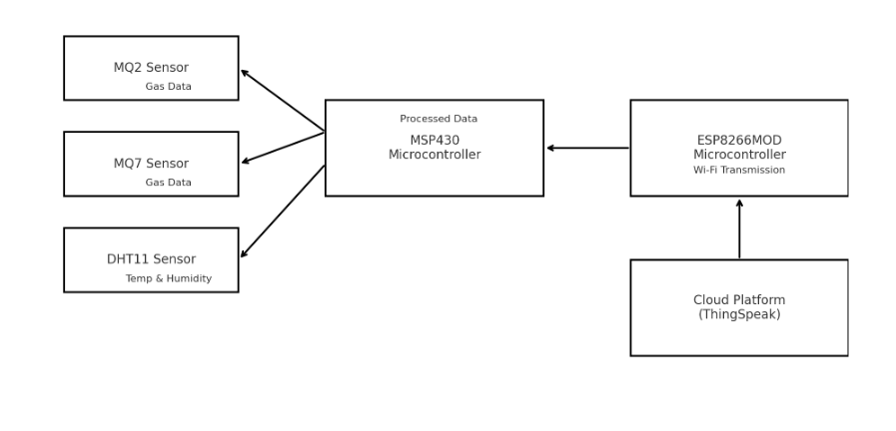
BLOCK DIAGRAM

Slide 10
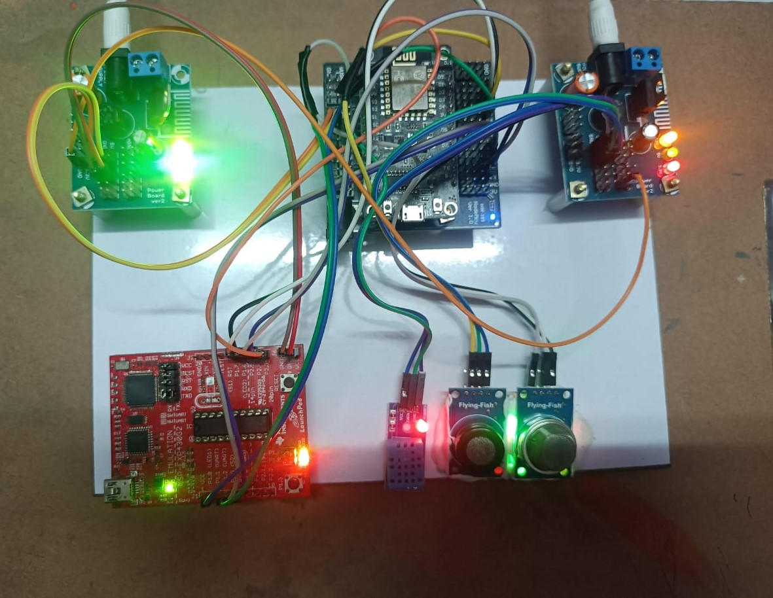
HARDWARE SET- UP

Slide 11
TESTING
Testing Environment: Simulated mining environment for system testing.
Data Collection: Results from sensor readings (gas, oxygen, temperature, etc.).
Mobile/Web Interface: Demonstration of the dashboard, graphs, and notifications.
System Performance: Accuracy, reliability, and responsiveness of the system in detecting hazardous conditions.

Slide 12
RESULTS AND ANALYSIS
Real-Time Monitoring: The system successfully captured and transmitted environmental data from underground conditions, including:
Gas concentrations (combustible gases and CO levels)
Temperature and humidity variations
Visualization on ThingSpeak:
Environmental parameters were visualized in real-time on the ThingSpeak cloud platform.
Data graphs for each parameter demonstrated seamless updates and clear trends.

Slide 13
Wireless Communication Performance: ESP8266MOD ensured stable and reliable data transmission using Wi-Fi. Effective signal transmission within the underground environment, overcoming moderate physical obstructions.
Energy Efficiency:
MSP430 microcontroller enabled low-power operation, crucial for underground deployment.
The system maintained extended functionality on a limited power source.

Slide 14
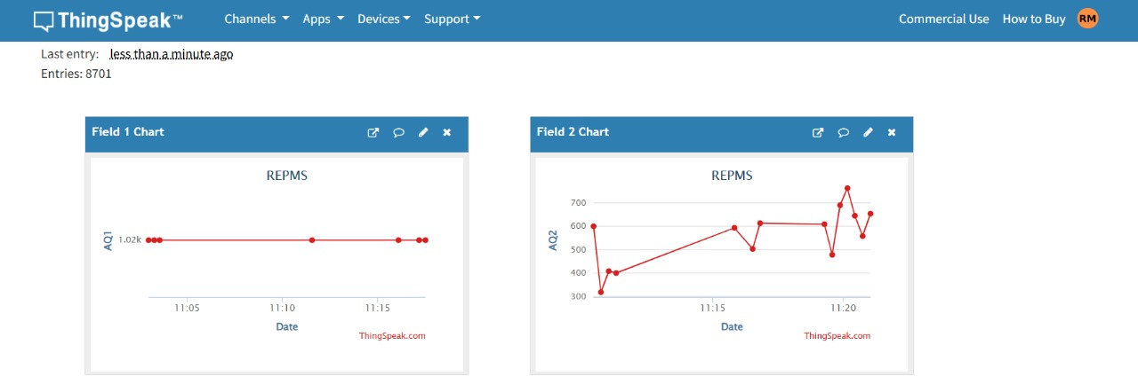
Visualization in ThingSpeak :

Slide 15
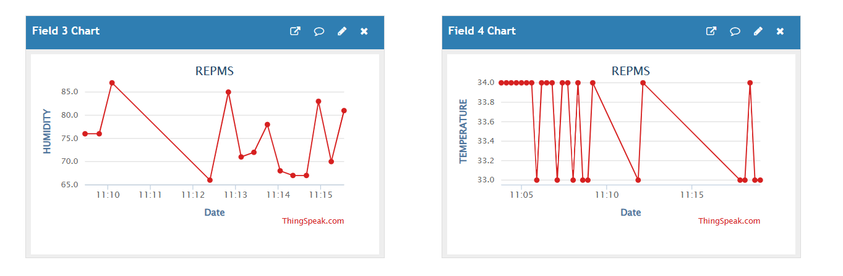
Visualization of Humidity and Temperature

Slide 16
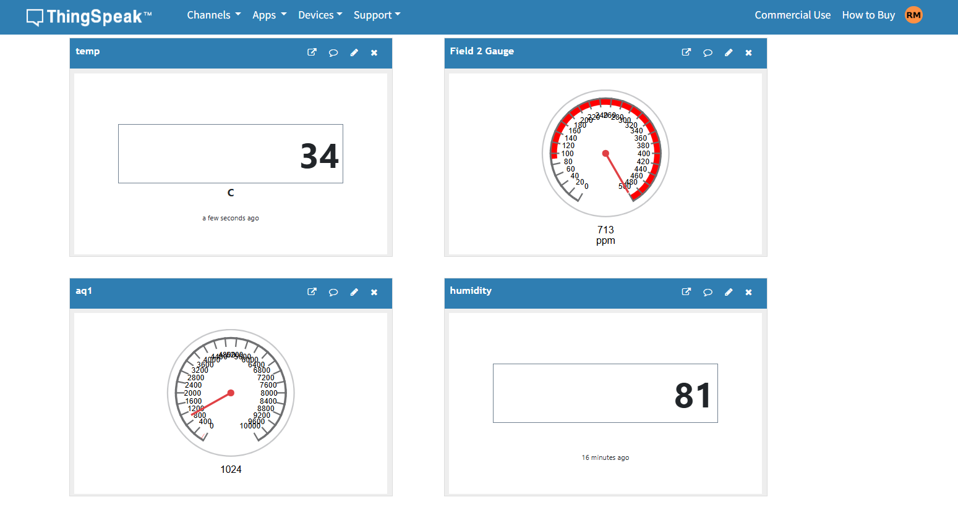
Visualization of Humidity and Temperature

Slide 17
BENEFITS OF THE SYSTEM
Improved Safety: Real-time monitoring and alerts for hazardous conditions.
Operational Efficiency: Continuous monitoring reduces the need for manual checks.
Cost-Effective: Low-power, affordable solution with scalable deployment.
Data-Driven Decisions: Real-time data helps in proactive decision-making for miner safety.
Adaptability: Suitable for various underground mining conditions.

Slide 18
CONCLUSION
Summary: The proposed Real-Time Environmental Parameters Monitoring System addresses key safety challenges in underground mining.
Impact: Enhanced miner safety, reduced accidents, and operational disruptions.
Future Prospects: Potential for further development and adoption across the mining industry.

Slide 19
FUTURE WORK
Integration with Other Systems: Combining with mine ventilation systems or automated mining operations.
Advanced Data Analytics: Use AI/ML for predicting and preventing hazardous conditions.
Expansion: Extending the system to larger, more complex mining environments.

Slide 20
REFERENCES
Saha, Susmita et al. “On Underground Coal Mine Environment Monitoring with LoRa Range Extension.” 2023 5th International Conference on Energy, Power and Environment: Towards Flexible Green Energy Technologies (ICEPE) (2023): 1-6.
Wei, Dong & Wang, Peiqi & Wang, Zhongbin & Si, Lei & Zou, Xiaoyu & Gu, Jinheng & Dai, Jianbo & Long, Chengyun. (2024). Adaptive Image Enhancement Method for Coal-Mine Underground Image Based on No-Reference Quality Evaluation. IEEE Transactions on Instrumentation and Measurement. PP. 1-1. 10.1109/TIM.2024.3470234.
Jiawei, Qiao. (2024). Application Research and Analysis of Image Enhancement Algorithms for Underground Coal Mines. 1314-1317. 10.1109/ITNEC60942.2024.10733038.
Wang, Lixin & Xu, Shuoshuo & Qiu, Junling & Wang, Ke & Ma, Enlin & Li, Chujun & Chunxia, Guo. (2020). Automatic Monitoring System in Underground Engineering Construction: Review and Prospect. Advances in Civil Engineering. 2020. 1-16. 10.1155/2020/3697253.

Slide 21
REFERENCES
Rao, Tianrong & Xu, Huijun & Pan, Tao. (2023). Pedestrian Detection Model in Underground Coal Mine Based on Active and Semi-supervised Learning. 104-108.10.1109/ICSIP57908.2023.10270885.
Ben-Awuah, Eugene & Richter, Otto & Tarrant, Elkington & Pourrahimian, Yashar. (2016). Strategic mining options optimization: Open pit mining, underground mining or both. International Journal of Mining Science and Technology. 26. 10.1016/j.ijmst.2016.09.015.
Åstrand, M. & Johansson, M. & Greberg, Jenny. (2018). Underground mine scheduling modelled as a flow shop: A review of relevant work and future challenges. Journal of the Southern African Institute of Mining and Metallurgy. 118. 10.17159/2411-9717/2018/v118n12a5.
M. Kanukuntla, S. Jannu and C. Thuppari, "A Novel Fleet Management System in Underground Coal Mines using Internet of Things," 2023 6th International Conference on Recent Trends in Advance Computing (ICRTAC), Chennai, India, 2023,
Pp.424-428,doi:10.1109/ICRTAC59277.2023.10480759.

Slide 22


